Slide 1
Image Filtering
Conservative Smoothing
Conservative smoothing is a very simple noise reduction method that trades noise suppression power with the ability to preserve image details.
It is effective in dealing with salt and pepper noise, because it ensures that each pixel’s intensity value is bounded withing the intensity range of its neighbors, but it is virtually useless, when dealing with additive noise.

Slide 2
Image Filtering
Conservative Smoothing
For this exercise, you are tasked to perform conservative Smoothing on an image that has been corrupted by noise.
The algorithm takes as input a noise image and the size of the conservative filter window and applies conservative smoothing to the image by comparing each pixel’s value to those of its neighboring pixels and, depending on the result, changing it to the minimum or Maximum value of the current pixel neighborhood. Then, it returns the filtered image. It uses 0-padding in order to avoid the creation of black borders in the image. Finally, the noise image is displayed alongside the filtered one.

Slide 3

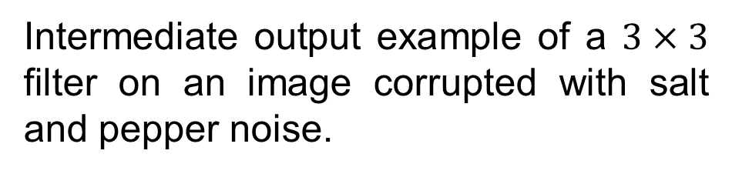
Image Filtering
Conservative Smoothing
Intermediate output example of a $3×3$ filter on an image corrupted with salt and pepper noise.
Input example.

Slide 4


Image Filtering
Conservative Smoothing
Output example of a $3×3$ filter on an image corrupted by Gaussian noise ($μ=0, σ^{2}=0.01$).

